Slide 1
Lesson 3
Mixed effects models:
An introduction

Slide 2
Assumptions of linear models
Linear models make many assumptions, including:
The model makes biological sense/ physical sense
Additivity (terms are added together)
Linearity
Independence of errors
Homoscedasticity – equal variance of errors
Normality of errors.

Slide 3
Fixed and random effects
Until now, we have treated all predictor variables as equal.
However, we can distinguish two types of fundamentally different predictor variables called:
Fixed effects, and
Random effects

Slide 4
Fixed effects vs Random effects
Fixed effects
are the predictor variables that we are interested in.
We want to understand their effect on the response variable (y).
They are specifically referred to in our hypotheses.
We can quantify/qualify their values.
e.g.
Q: Do forest types differ in their understory productivity?
Predictor: 3 Forest types: beech, podocarp, mixed
Response: understory biomass

Slide 5
Fixed Effects
Are we interested in effect sizes?
Are the factor levels informative?
Are the factor levels experimental manipulations?
If yes, it is a fixed effect

Slide 6
Fixed Effects vs Random effects
Random effects
are additional variables we include in the model which can explain some of the variance in Y.
We are not interested in them, but they are useful for two reasons:
They increase our test power as they reduce the residual error by explaining some variance in our data
More importantly, they correct for dependence between data points

Slide 7
Why use MMs?
To properly account for dependence structure of data and thus sidestep pseudoreplication (dependency)
To treat fixed and random effects appropriately
Fixed effects: Estimate and test
Random effects: Predict and test variance components
Get more appropriate estimates (including benefits of shrinkage -> next lecture)
Get better residual distributions
To circumvent missing-value problems associated with ANOVA

Slide 8
Example: Spatial blocks
Height differences between tree species

Slide 9
Example: Spatial blocks
Height differences between tree species

Slide 10
Example: Spatial blocks
Height differences between tree species

Slide 11

Example: subject effects
Experiment looking at drug effect on blood sugar over time in dogs
Each individual has a unique trait range (data pts from each dog are linked)
Treat
Dog 3
Placebo
Blood sugar
Dog 8
time

Slide 12
MM: fixed and random effects
Fixed effect: predictors we care about
E.g. drug treatment, time (in our Hypotheses/ questions)
Random effect: predictors we don’t care about, but which might be causing variation in the data e.g. dogID
Treat
Placebo
Blood sugar
time

Slide 13
Linear MMs in R: lmer() statement
There are numerous packages in R for mixed model analysis , but we will mostly consider lme4 here.
Consider a crop yield experiment with two fertilizer treatments, each with multiple levels (N, P) and fully crossed in repeated blocks.
The lmer() model statement specifies the fixed factors (N*P) and the structure of the random factors (1|Block).
M2 <- lmer(Yield ~ N*P + (1|Block),df3)

Slide 14
Mixed models: lmer() output
> summary(M2)
Linear mixed model fit by REML
Formula: Yield ~ N * P + (1 | Block)
Data: df3
AIC BIC logLik deviance REMLdev
264.3 271.3 -127.1 270.4 254.3
Random effects:
Groups Name Variance Std.Dev.
Block (Intercept) 90.899 9.5341
Residual 470.305 21.6865
Number of obs: 30, groups: Block, 5
Fixed effects:
Estimate Std. Error t value
(Intercept) 7.500 16.401 0.457
N 22.267 7.919 2.812
P 0.650 4.849 0.134
N:P -8.700 9.741 -0.893
For random effects, only their variance components are shown. Why? Because random effects are assumed to have mean = 0 (or rather that their means are unimportant to us).
Mixed models deal with unbalanced designs (among other problems), for which df are hard to estimate. No df’s means t-probabilities cannot be calculated!

Slide 15
e.g. Repeated Measures Design
Example: Drugs affecting blood histamine in dogs
Question:
Does the rate of change of
histamine level depend
on drug or starting level
of histamine?

Slide 16

Repeated Measures Designs
Example: Drugs affecting blood histamine in dogs
8 normal, 8 with depleted histamine levels(=between-subjects factor)[D]
Four of each type treated with morphine or trimethaphan [M] (=second between subjects factor).(i.e. 4 dogs per treat per type)
M
T
M
T
T
M
M
T
T
T
M
T
M
M
T
M
Blood samples taken for analysis of histamine levels just before the drug dose (time 0) and then at 1, 3 and 5 minutes after injection (=within subjects factor).
Analysis: histamine~D*M*Time+Error(DogID/Time)

Slide 17
Repeated Measures Designs
Really a special form of nested design
Model: Response~A*T+Error(A/Time)
[must have unique coding for each subject]
A₁ |  | A₁ |  | A₁ |  | A₂ |  | A₂ |  | A₂
T₁ |  | T₁ |  | T₁ |  | T₁ |  | T₁ |  | T₁
T₂ |  | T₂ |  | T₂ |  | T₂ |  | T₂ |  | T₂
T₃ |  | T₃ |  | T₃ |  | T₃ |  | T₃ |  | T₃
T₄ |  | T₄ |  | T₄ |  | T₄ |  | T₄ |  | T₄
Time

Slide 18
Example 3.1

Slide 19
LMMs: very simplified mathematics
Mixed models are linear models with a component for fixed factors and variates (Xβ) and a component for random factors (Zb)
y = Xβ + Zb + ε, b∼N(0,Ψ), ε∼N(0,σ²)
Importantly, the coefficients of the random variables are assumed to have a normal distribution around a mean of zero.
We are only interested in removing the variance (Ψ) the random effect levels account for.

Slide 20
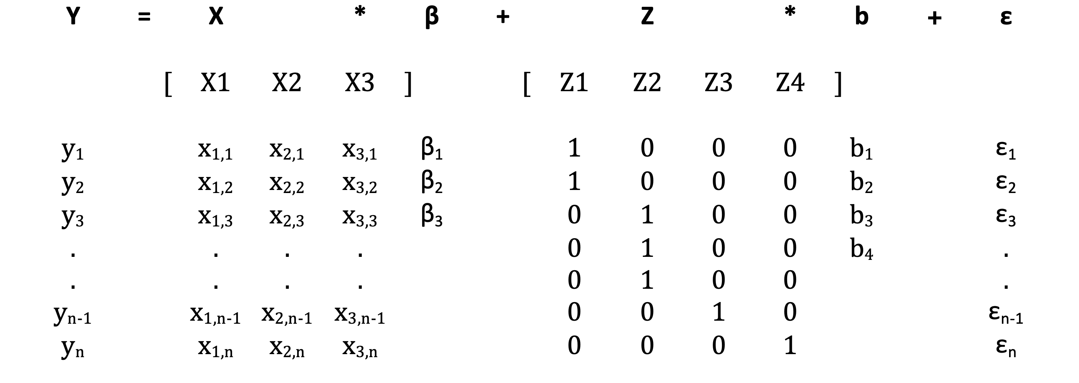
y = Xβ + Zb + ε expanded
=
+
+
(px1)
(qx1)
b ∼ N ( 0, Ψ)
(nx1)
(nxp)
(nxq)
(nx1)
ε ∼ N ( 0, σ²)

Slide 21
MM: geometry
Response (Y): Blood sugar
Fixed effect: time
Random effect: dogID
Model: Sugar ~ time + (1|dogID)
Fixed effect
Random effects
b_{i} ∼ N ( 0, Ψ)
ε_{i} ∼ N ( 0, σ²)
Blood sugar
time
time

Slide 22
MMs are solved with REML
Mixed models are solved with Restricted maximum likelihood (REML) to get unbiased estimates of variances, and maximum likelihood (ML) for nested model comparison (LRTs)
I do not fully understand the maths behind REML so i will explain the ML estimation here as ML and REML yield identical estimates for the coefficients (β_{i})

Slide 23
Recall MLE for the linear model
The linear model has the following form
y = Xβ + ε where ε ∼ N( 0,σ²I)
Remember that ε is a vector of
errors around the fitted line.
now ε =σ² I = V, the covariance matrix
2
2
2
x
=
2
2

Slide 24
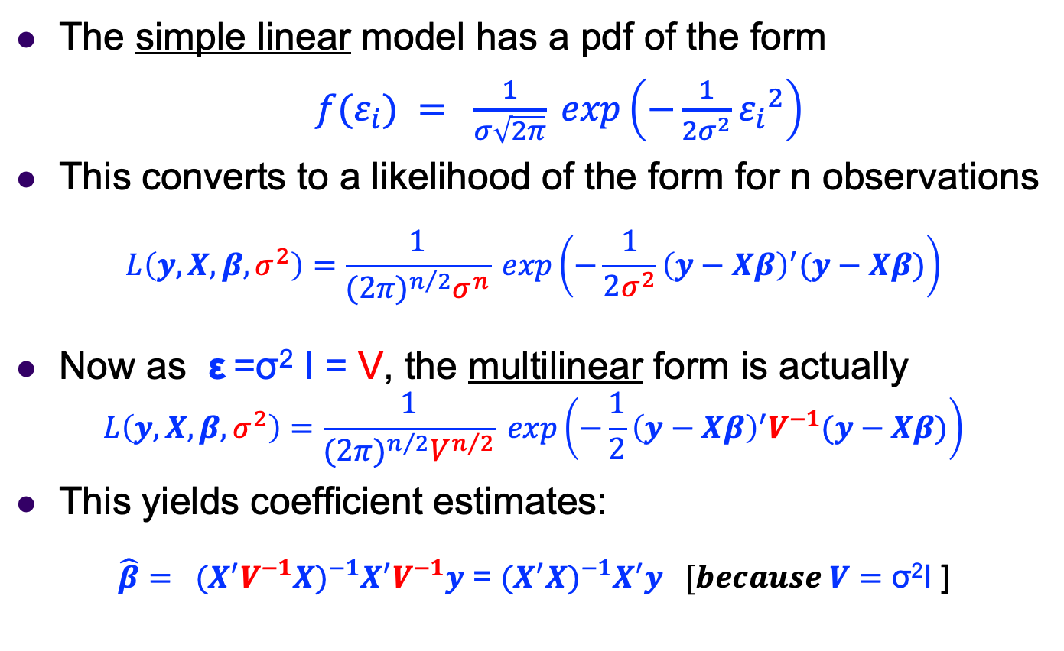
Recall MLE for the linear model
The simple linear model has a pdf of the form
$f(ε_{i}) = \frac{1}{σ\sqrt{2π}} exp\left(−\frac{1}{2σ^{2}}{ε_{i}}^{2}\right)$
This converts to a likelihood of the form for n observations
$$L\left(y,X,β,σ^{2}\right)=\frac{1}{{(2π)}^{n/2}σ^{n}} exp\left(−\frac{1}{2σ^{2}}{\left(y−Xβ\right)}^{′}(y−Xβ)\right)$$
Now as ε =σ² I = V, the multilinear form is actually
$$L\left(y,X,β,σ^{2}\right)=\frac{1}{{(2π)}^{n/2}V^{n/2}} exp\left(−\frac{1}{2}{\left(y−Xβ\right)}^{′}V^{−1}(y−Xβ)\right)$$
This yields coefficient estimates:
$\hat{β}= {{(X}^{′}V^{−1}X)}^{−1}X^{′}V^{−1}y$ = ${{(X}^{′}X)}^{−1}X^{′}y [because V=\text{σ}\text{2}\text{I}$]

Slide 25
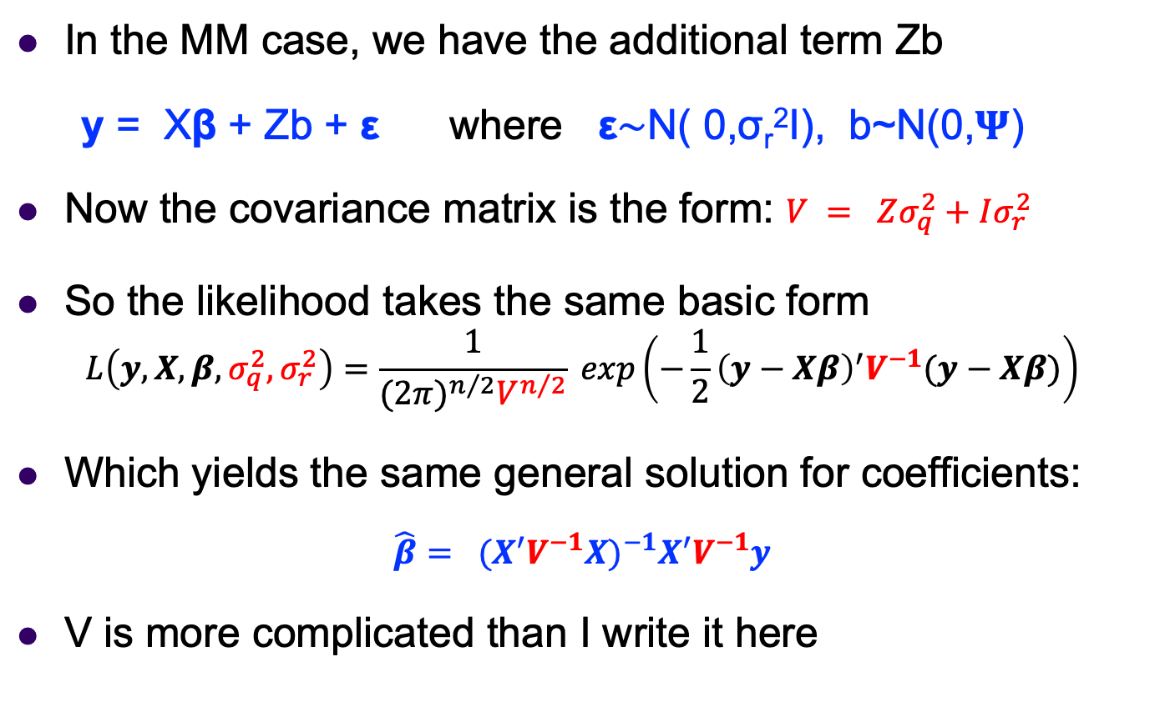
MLE for the MM model
In the MM case, we have the additional term Zb
y = Xβ + Zb + ε where ε∼N( 0,σ_{r}²I), b~N(0,𝚿)
Now the covariance matrix is the form: $V = Zσ_{q}^{2}+Iσ_{r}^{2}$
So the likelihood takes the same basic form
$$L\left(y,X,β,σ_{q}^{2},σ_{r}^{2}\right)=\frac{1}{{(2π)}^{n/2}V^{n/2}} exp\left(−\frac{1}{2}{\left(y−Xβ\right)}^{′}V^{−1}(y−Xβ)\right)$$
Which yields the same general solution for coefficients:
$$\hat{β}= {{(X}^{′}V^{−1}X)}^{−1}X^{′}V^{−1}y$$
V is more complicated than I write it here

Slide 26
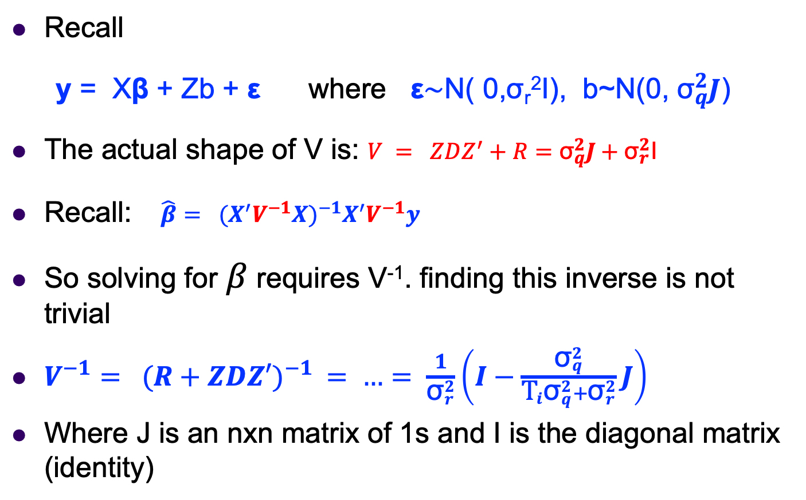
The form of covariance V
Recall
y = Xβ + Zb + ε where ε∼N( 0,σ_{r}²I), b~N(0, ${\text{σ}}_{q}^{2}J$)
The actual shape of V is: $V = ZDZ^{′}+R=$ ${\text{σ}}_{q}^{2}J+{\text{σ}}_{r}^{2}$I
Recall: $\hat{β}= {{(X}^{′}V^{−1}X)}^{−1}X^{′}V^{−1}y$
So solving for $β$ requires V⁻¹. finding this inverse is not trivial
$V^{−1}= {(R+ZDZ′)}^{−1} = …= \frac{1}{{\text{σ}}_{r}^{2}}\left(I−\frac{{\text{σ}}_{q}^{2}}{{{\text{T}}_{i}\text{σ}}_{q}^{2}+{\text{σ}}_{r}^{2}}J\right)$
Where J is an nxn matrix of 1s and I is the diagonal matrix (identity)

Slide 27
End of Lesson 3

